Slide 1
LASERS IN PERIODONTAL THERAPY

Slide 2
INTRODUCTION
“LASER” is an acronym for “light amplification by stimulated emission of radiation.”
Light is a form of energy that travels in a wave and exists as a particle.
This particle is called a photon.
Photons are the smallest units of energy and are generally regarded as having zero mass or charge.
When subjected to higher energy levels they undergo amplification, stimulation which consequently emits a monochromatic coherent energy photons called LASER.

Slide 3
HISTORICAL BACKGROUND
Laser initially was called “Maser”. MASER is an acronym for “Microwave Amplification by Stimulated Emission of Radiation.”
This principle was invented in 1958 by Schawlow and Townes of the Massachusetts Institute of Technology.
Nobel Prize for development of laser was given to Towne, Basov, Prokhorov in 1964

Slide 4
properties of Laser

Slide 5
MonochroMatic Light
Mono chromatic light has a very narrow range of frequency and single wavelength (i.e. it is only made of light of one colour)

Slide 6
coherence
All the emitted photons are in phase with each other and have identical peaks and valleys.

Slide 7
directionaLity

Slide 8
parts of a Laser
Active medium/Gain:
Gas , solid, liquid suspended in an optical cavity.
Power supply: external energy source- flash lamp/ electrical energy.
Optical resonator: mirrors for amplification.
Cooling system, Control system, Delivery system.

Slide 9
MAIN COMPONENTS OF LASER

Slide 10
CLASSIFICATON OF LASER SYSTEM

Slide 12
Laser deLivery systeMs

Slide 13
Modes of operation of Laser
Continuous wave
Gated pulsed mode (Physical gating of beam)
Free running pulsed mode (Property of the active medium)

Slide 14
EFFECT OF LASER ON TISSUES

Slide 15
tHeOreticaL ZOnes Of tissue cHange assOciateD WitH sOft tissue eXpOsure tO Laser LigHt

Slide 16
tHeOreticaL ZOne Of tissue cHange assOciateD WitH HarD DentaL tissue eXpOsure tO Laser LigHt

Slide 17
CHARACTERISTICS OF LASER THERAPY
Penetration depth of lasers
Tissue ablation
Thermal side effects and hemostasis
Disinfection and detoxiﬁcation effects
Biostimulation (photobiomodulation)

Slide 18
Penetration depth of lasers

Slide 19
Tissue ablation
Soft tissue ablation- CO2, Nd:YAG, Diode.
“Photo-thermal effect”
Hard tissue ablation- Er Group
“Thermo-mechanical effect”

Slide 21
Thermal side effects and hemostasis
LASER | COAGULATION DEPTH
Nd:YAG | 0.3-0.8mm (Perry et al and white et al)
Diode | 1mm (White et al)
CO2 | 100-300µm (Arashiro et al)
Er:YAG | 10-50µm (Walsh et al)
Er: YAG Hard tissue | 5-30µm on cementum, dentin and bone

Slide 22
Disinfection and detoxiﬁcation effects
Killing bacteria by “photo-thermal effects”.
Bacteria are evaporated, destroyed or denatured by laser irradiation, resulting in their devitalization or inactivation.
Nd:YAG laser exhibits selective absorption in pigments.
Ablate or inactivate toxic substances, such as bacterial endotoxins (lipopolysaccharide).

Slide 23
Biostimulation (photobiomodulation)
Biostimulatory effects may allow faster or more favorable wound healing, relative to conventional mechanical therapy.
Photobiomodulation effects, such as promotion of cell proliferation and differentiation, anti-inﬂammatory effects positively modulate wound healing.
Rate of wound healing is strongly inﬂuenced by the degree of remaining collateral thermal injuries.
Low level co2 laser has a good tissue remodelling property.

Slide 24
WHat DOes tHe OperatOr cOntrOL

Slide 25
lasers
Advantages
Hemostasis.
Ablation.
Detoxification.
Bactericidal activity.
Osseous tissue removal and contouring easy with Er family
Disadvantages
Hard tissue damage (bone)
High cost.
Risk of pulpal damage.
No single wavelength can treat all diseases

Slide 26
Why lasers in periodontiCs…
Conventional methods
 Bleeding- surgical field.
 Suturing.
 Local anesthesia.
 Post-operative discomfort.
 Healing time.
 Post-operative complications.
 Infection.
 Periodontal dressings.
LASER
 Effective hemostasis.
 No sutures. (concept of tissue welding).
 Topical anesthetic- some procedures.
 Faster healing.
 Minimal/no post operative complications.
 Laser sterilization of wound site.
 Laser bandage.

Slide 27
PERIODONTAL APPLICATIONS
Calculus removal
Soft tissue excision
Incision
Ablation
Decontamination of root and implant surfaces
Biostimulation
Bacteria reduction
Bone removal (osseous surgery).
Removal of gingival pigmentation
Reduction of periodontopathogenic black‑pigmented bacteria.
Management of dentinal hypersensitivity

Slide 28
gingival soft tissue proCedures
Advantages of lasers over conventional:
○ Hemostasis.
○ Ablation.
○ Little wound contraction/ minimal scarring.
○ Faster healing.
○ Less post-operative discomfort.
○ Less risk of damage to underlying structures as compared to cautery.

Slide 29
gingival soft tissue proCedures
Indications:
○ Gingivectomy.
○ Gingivoplasty.
○ Frenectomy/ frenotomy.
○ Vestibuloplasty.
○ Operculectomy.
○ Depigmentation.
Lasers used;
○ Diode.
○ Nd YAG.
○ Er YAG.
○ Co2.
Diode and Nd YAG: deep penetration .
Er YAG, Co2: superficial action.

Slide 30
gingival soft tissue proCedures
Diode and Nd YAG: Co2 laser:
Effective for cutting and reshaping of soft tissue.
Good hemostasis
Greater thermal effects.
Thicker coagulated layer.
Rapid ablation of soft tissue.
Good hemostasis.
Effective even for thick tissue.
Risk of charring- thermal damage.

Slide 31
gingival soft tissue proCedures.
Er YAG :
Fine cutting can be done.
Less hemostasis as compared to other lasers.
Very less thermal damage: use with irrigation.
Width of thermally affected layer: 5-20 microns
Er YAG:
Safer even in thin tissues.
Useful to remove melanin and metal tattoos.

Slide 32
non surgiCal therapy
Introduction:
Primarily aimed at efficient removal of plaque and calculus and reduction of bacterial load, inflammation.
Conventional therapy limitations:
○ Incomplete removal of calculus.
○ Incomplete elimination of inflamed pocket lining.
Lasers used: Diode, Nd YAG, Er YAG, Co2 lasers.

Slide 33
subgingival CalCulus deteCtion- unique appliCation for laser
Conventional method- tactile feel.
Latest: Er YAG laser with fluorescent feedback system for calculus detection.
Rationale:
Difference in the fluorescence emission properties of calculus and dental hard tissue when subjected to irradiation with 655 nm diode laser.

Slide 34
root surfaCe alterations
Diode laser
Nd YAG laser
surface pitting, craters, melting, carbonization of root surface.
decrease in protein/mineral ratio, production of protein by- products.
Nd YAG treated root surface – not favorable for fibroblast attachment.
Laser followed by SRP- restores the biocompatibility of root surface
Dry or saline moistened root surfaces- no detectable alterations.
Blood coated specimens- charring

Slide 35
CO2 Laser
Carbonized layer on root surface.
Cyanamide , cyanate ions- detected on the carbonized layer- FTIS method.
Char layer inhibits periodontal soft tissue attachment.
Co2 laser contraindicated for root surface treatment in focused mode.
Erbium family
No thermal effects such as cracking, fissuring.
No major chemical or compositional change- on root cementum or dentin.
Biocompatability of root surface: micro-irregularity offers better attachment to fibroblasts

Slide 36
baCterial reduCtion
The only two soft tissue wavelengths that currently meet the criterion of having a delivery system able to deliver laser energy efficiently and effectively to the periodontal pockets for nonsurgical periodontal therapy are Nd:YAG and diode.
Well absorbed by melanin and hemoglobin and other chormophores present in periodontally diseased tissues. The laser energy is transmitted through water and poorly absorbed in hydroxyapitite.

Slide 37
Both of these wavelengths have been shown to be extremely effective against periodontal pathogens in vivo and in vitro
 diode laser revealed a bactericidal effect, helped reduce inflammation, and supported healing of the periodontal pockets through the elimination of bacteria.

Slide 38
surgicaL Pocket theraPy- Lasers
Lasers used: Co2 and Erbium family
Involves use of lasers for
calculus removal,
○
○ osseous surgery,
○ de-toxification of the root surface and bone,
○ granulation tissue removal
Advantage of Laser:
Better access in furcation areas, hemostasis, less post- operative discomfort, faster healing.

Slide 39
LANAP

Slide 40
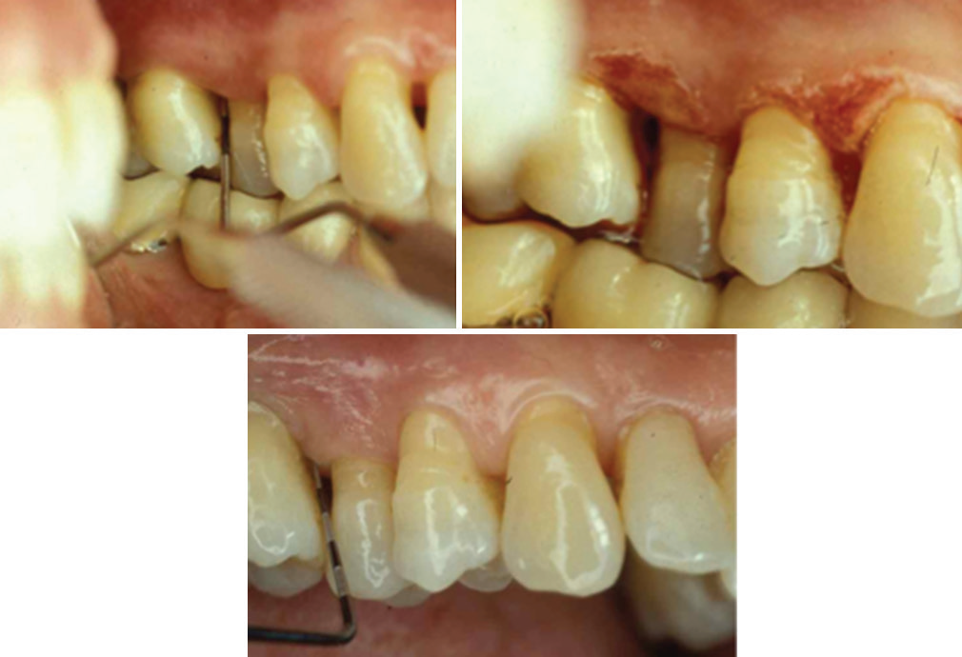
“LASER‑ASSISTED GUIDED TISSUE REGENERATION.”
a
b
c
(a) Preoperative clinical condition; (b) clinical condition after laser‑assisted scaling and root planing in conjunction with a de‑epithelialization of the oral and sulcular epithelium for pocket reduction using an Nd: YAG laser; (c) stable long‑term clinical condition (5 years postoperative)

Slide 41
imPLant theraPy- management of Peri-
imPLantitis
Peri-implantitis – Management options-
Conventional- plastic curettes and antibiotics.
New option- Laser Rationale:
○ Disinfection and de-contamination of implant surface.
○ Granulation tissue removal.
Lasers used: Diode, Co2, Erbium family.
Lasers contra-indicated: Nd YAG (Implant damage).

Slide 42
Low LeveL Lasers
▪Helium – neon laser
▪Gallium – aluminum – arsenide diode laser
▪Gallium – arsenide diode laser
▪Argon ion laser
▪Defocused Co₂ laser
▪Defocused Nd:YAG laser

Slide 43
BiostimuLation effects of Low LeveL Laser
○ Reduction of discomfort / pain
○ Promotion of wound healing
○ Bone regeneration
○ Suppression of inflammatory process.
○ Activation of gingival and periodontal ligament fibroblast, growth factor release
○ Alteration of gene expression of inflammatory cytokines
○ Photobiostimulaation

Slide 44
Photodynamic theraPy in Laser
Main objective of periodontal therapy: eliminate the deposits of bacteria.
Conventional mechanical therapy: due to
Anatomical complexity of root. Deep periodontal pockets.
incomplete elimination

Slide 45
PrinciPLes Behind Pdt
PS
light
1_{O1O2}
2
TARGET CELL
1_{O1O2}
2
1_{O1O2}
2
1_{O1O2}
2
Cell death

Slide 46
destruction of PeriodontoPathogenic Bacteria
Polysaccharides in biofilm are highly sensitive to singlet oxygen.
During inflammation reduced O₂ consumption
change in pH growth of anaerobes

Slide 47
PDT
tissue blood flow and venous congestion
oxygenation of gingival tissues 21– 47 %
The activity of PDT ..been reported in vitro and in vivo .
 Greater bacterial reduction of S.sanguis numbers compared with A. actinomycetamcomitans.

Slide 48
heaLing after Laser theraPy
o
Laser created wounds heal more quickly and produce less scar tissue than conventional scalpel surgery.
o more initial tissue damage may result, and that wounds have less tensile strength during the early phase of healing.

Slide 49
laser safety
Regulatory organizations:
CDRH→ center for devices and radiologic health
ANSI→American National Standards Institute
OSHA→ occupational safety and health administration
Laser safety officer.
Environment: warning signs, restricted access, reflective surface minimized.
Laser use documentation.
Training.
Eye and tissue protection.

Slide 50
Classification of LASER- based on safety
Based on the potential of the primary laser beam or the reflected beam to cause biologic damage to the eye or skin.
Four basic classes:
○ Class I.
○ Class II: a,b
○ Class III: a, b
○ Class IV.

Slide 51
cLassificatiOn Of Lasers
Class I lasers
Do not pose a health hazard.
Beam is completely enclosed and does not exit the housing.
Max power output: 1/10 th of milliwatt
Eg: CD player.
Class II Lasers:
Visible light with low power output.
No hazard- blinking and aversion reaction.
Max power output is 1 mW.
Eg: bar code scanner, laser pointer
Two subdivisions:
IIa: dangerous- >1000 sec.
IIb: ¼ th of second.

Slide 52
Laser cLassificatiOn
Class IIIa:
Any wavelength.
Max Output power: 0.1 to
0.5 W.
Danger > ¼ th of a second.
Caution label.
Class IIIb:
Hazard to eye- direct or reflected beam, irrespective of time of exposure.
Safe with matted surface and no fire hazard.
Max output power: 0.5 to 5W.

Slide 53
cLassificatiOn Of Lasers
Class IV lasers:
Hazardous for direct viewing and reflection.
Max output power > 5 W.
Fire and skin hazards.
Use safety glasses
Dental lasers are Class IIIb or Class IV lasers.

Slide 54
recent advances
WATERLASE
Device that uses laser energized water to cut and coaglate soft and hard tissue.
Er, Cr: YSGG laser 2,780nm - available as WATERLASE

Slide 56
uses
Full thickness flap
Partial thickness flap Split thickness
Laser soft tissue curettage
Laser removal of diseasd, infected, inflamed, necrosed tissue within the periodontal pocket
Removal of inflamed tissue, osteoplasty, osseous recontouring……

Slide 57
Periowave
Photodynamic disinfection system utilizes nontoxic dye in combination with a low-intensity lasers enabling singlet oxygen molecules to destroy bacteria.

Slide 58
concLusion
Lasers in dentistry offer incredible precision, less pain, faster healing and many more advantages.
It is most important for the dental practitioner to become familiar with those principles and choose the proper laser for the intended clinical application.

